Slide 1
Project Analysis feedback
What Went Well
Gathering stakeholder information
Lots of students really described and justified in detail how their proposed stakeholders would make sure of their project.
Computational methods
Discussing Computational methods and applying to the project.
Points to consider!
Act on feedback provided – Make sure to amend your project and re-submit your work if necessary for checking to make sure you are now hitting the higher bounds of the mark scheme. If you do it now, it will save you time in the long run.
Unity coding – Unity can provide a lot of code for you, please be aware of this.
Multi-player/AI – Make sure that your game is either multiplayer or against the PC in some way. Multi-player is easier!
Always look at the higher band on the mark sheet – Aim high, always look at the top band and make sure your work meets the requirements.
Use the example projects from previous students but… don’t copy them.
Please use headings in word.
If you change your idea, do not start again, just mention why you have done it
Even Better If
Justification Is always an issue when writing the project. Why have you chosen to do it this way. Refer to research and stakeholder interviews etc.
Research Some students only researched one game/similar solution. The mark scheme says solutions! Also need to use that research to inform choices to your project.

Slide 2
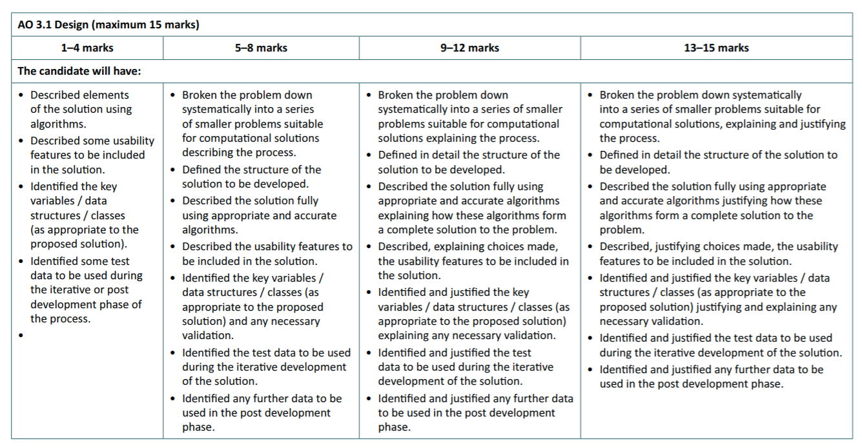

Slide 3
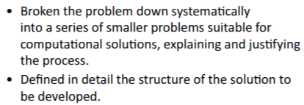
Require – Knowing the Mark scheme
This should include a top down structured diagram of all of the key components of your project.
For most A-level projects this will be quite a complex diagram.
Both mark scheme points go hand in hand.

Slide 4
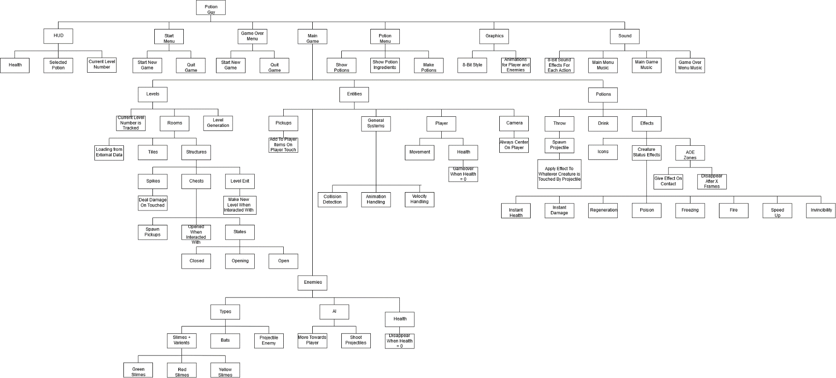

Slide 5
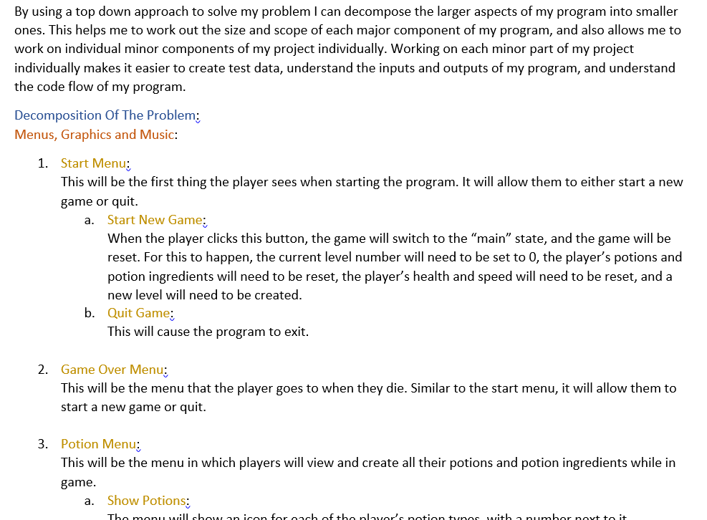

Slide 6
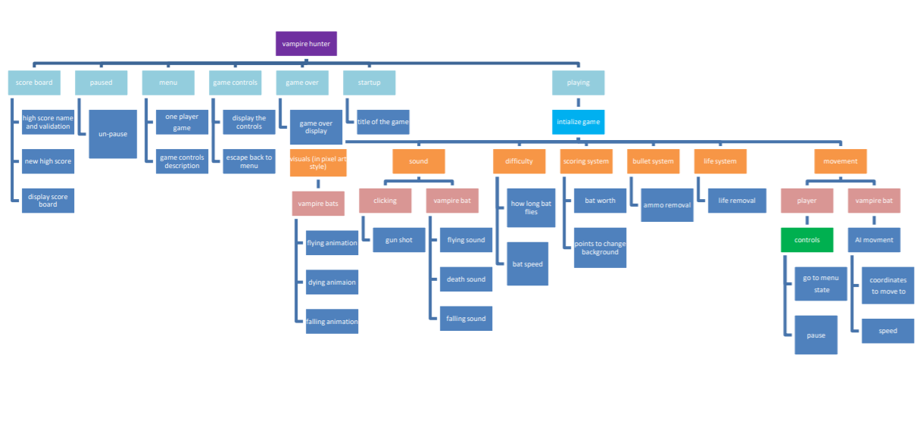

Slide 7
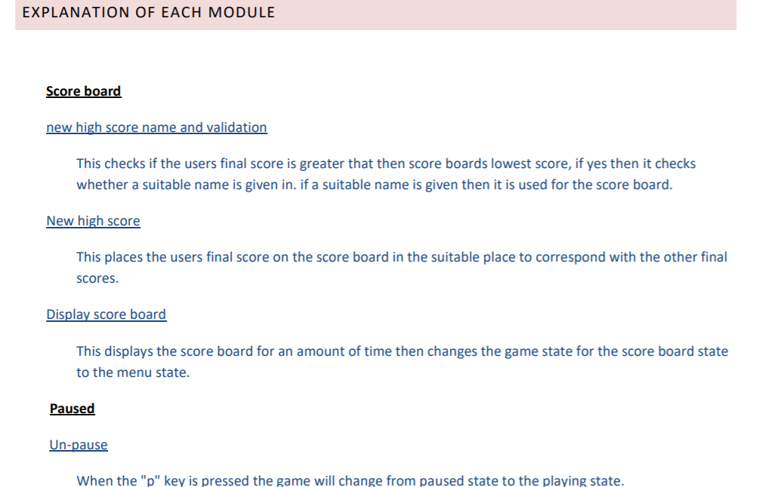

Slide 8

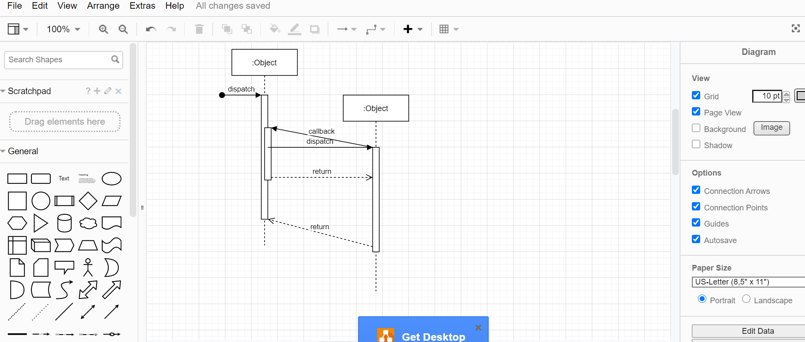
Programs to use
Apps.diagrams.net
Microsoft Visio (free with office 365 subscriptions)

Slide 9
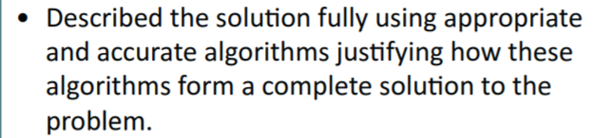
Require – Knowing the Mark scheme
Algorithms can be in the form of flowcharts and pseudo code.
At A-level I would expect to see both of these.
Pseudo code should be included.

Slide 10

Can be found on Firefly-> Faculties -> Technologies -> Computing -> KS5 - >OCR H446 – Component 3 –Project

Slide 11
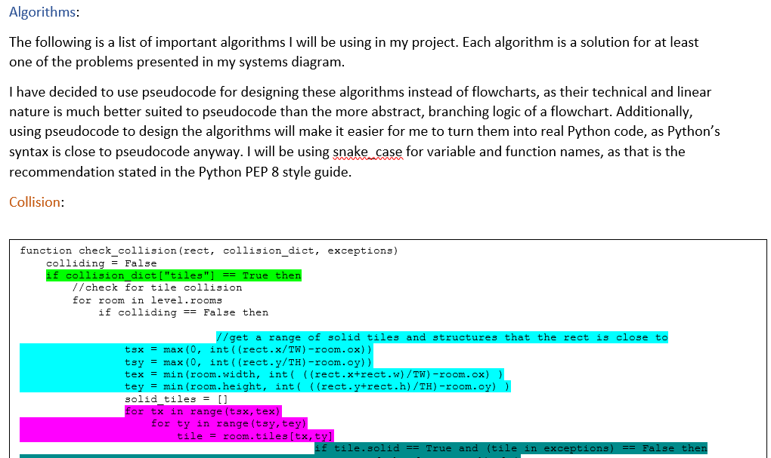

Slide 12
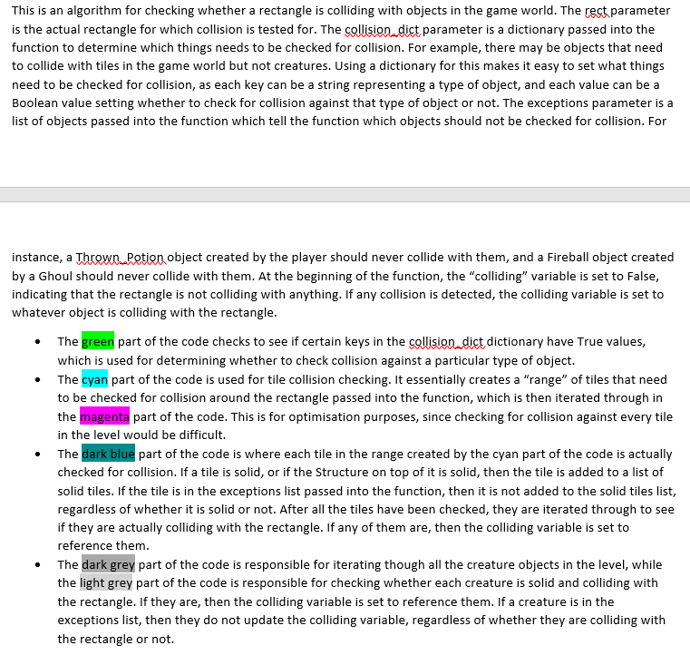

Slide 13
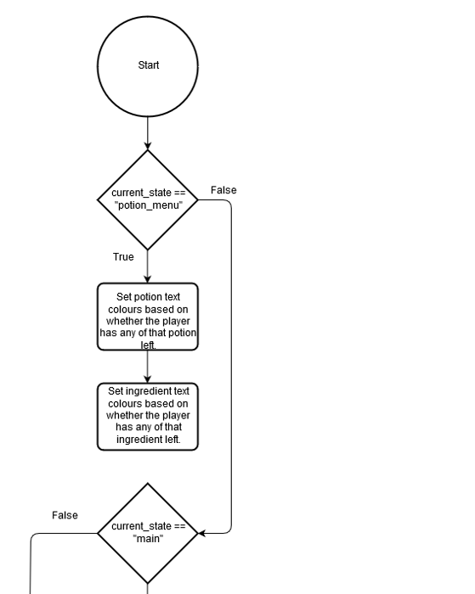

Slide 14
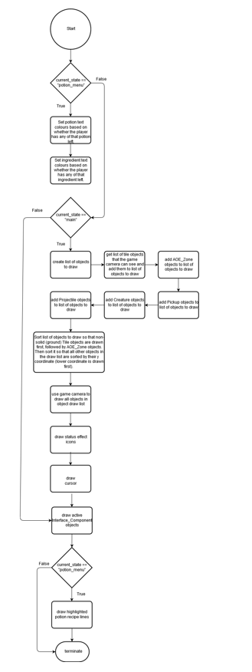

Slide 15
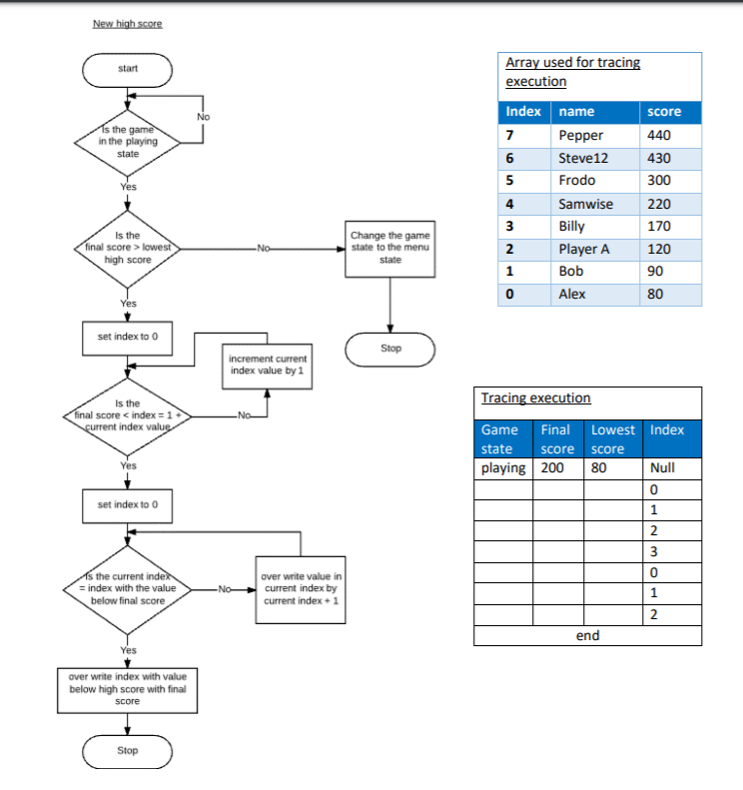

Slide 16
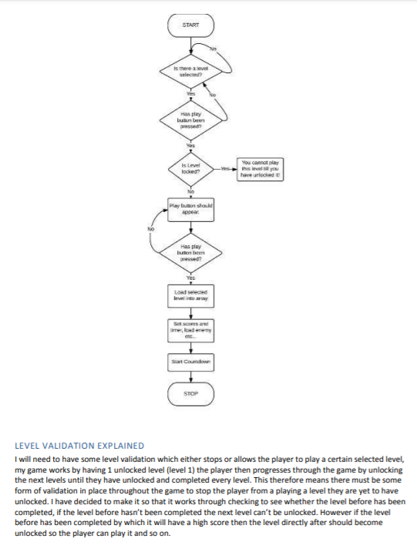
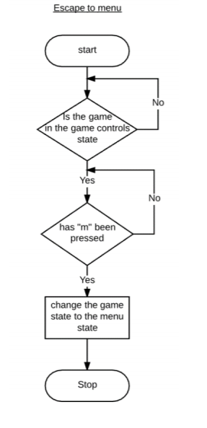

Slide 17
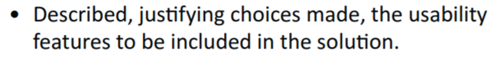
Require – Knowing the Mark scheme
Should include detailed examples of the what the usability features will look like.
These should be labelled with features and an explanation of WHY they are going to be included and WHY you have chosen for them to look that way.
These can be done in paint, Photoshop or even on paper.

Slide 18
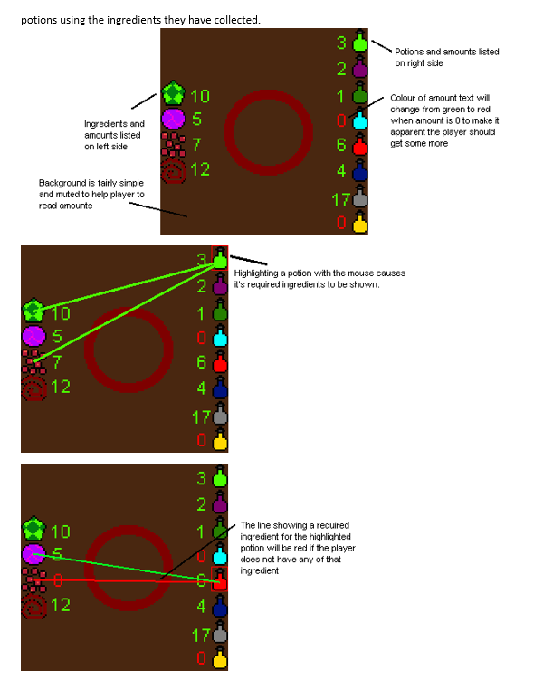
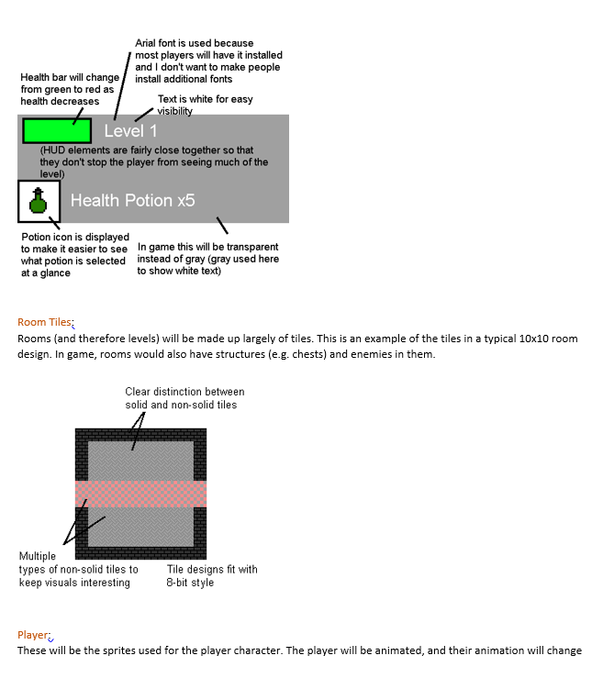

Slide 19
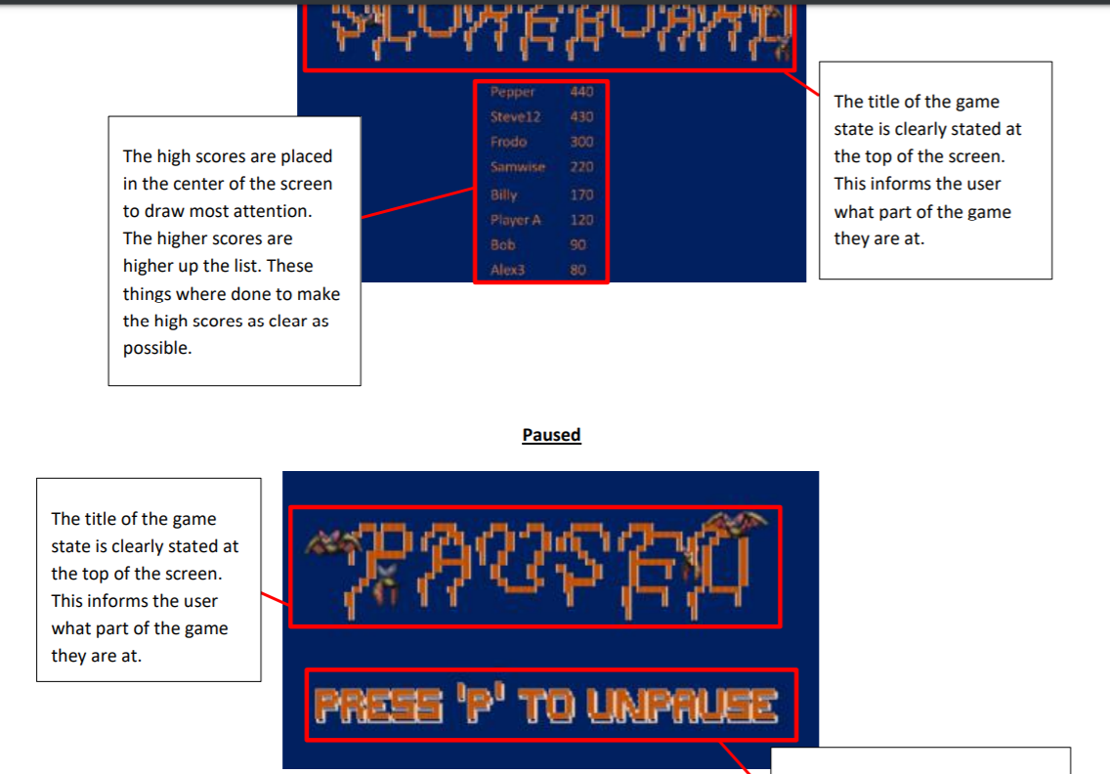

Slide 20
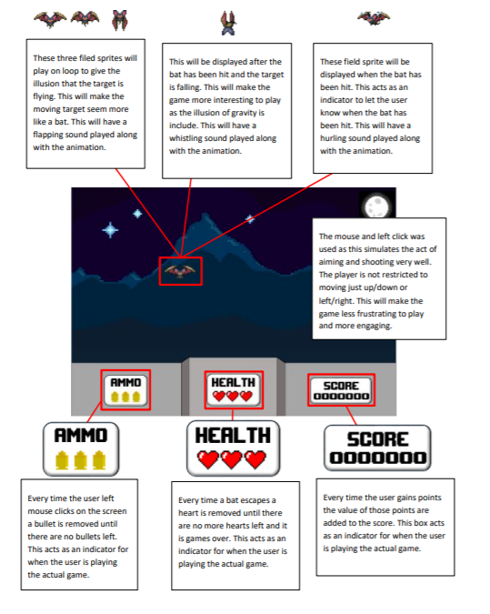

Slide 21
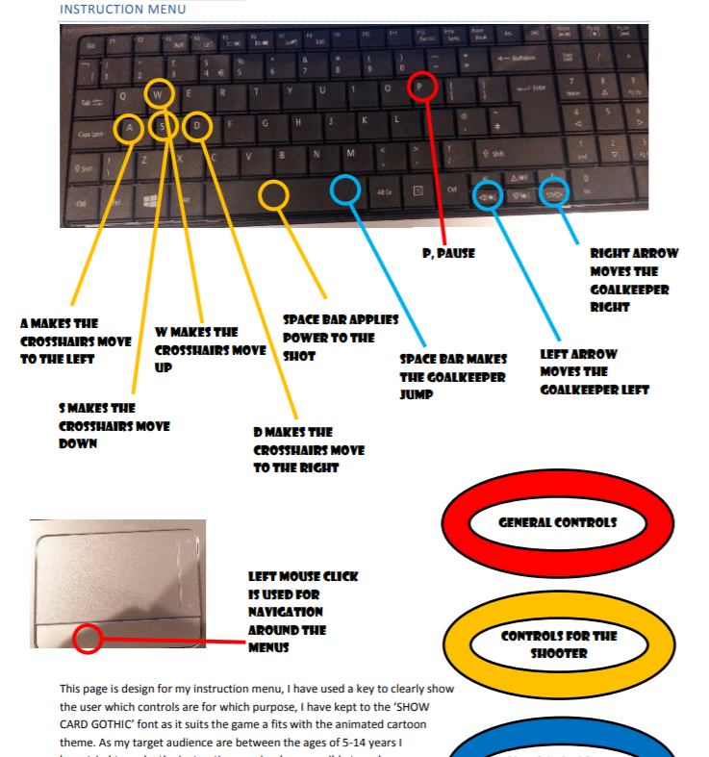

Slide 22
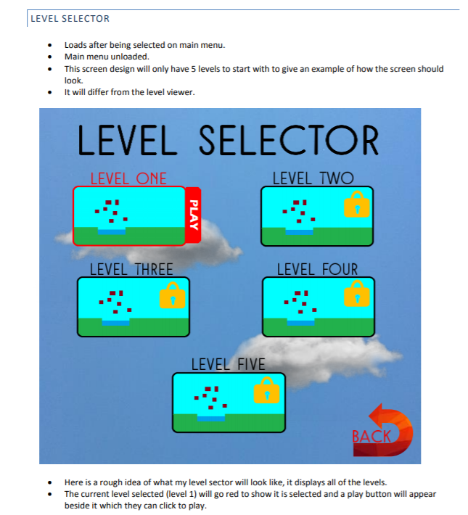

Slide 23
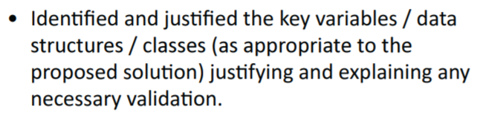
Require – Knowing the Mark scheme
Data structures/classes and key variables should be identified.
Your decision to include these should be justified and explained.
Not every class and variable needs to be identified but at this point you should have an idea of the key ones.

Slide 24
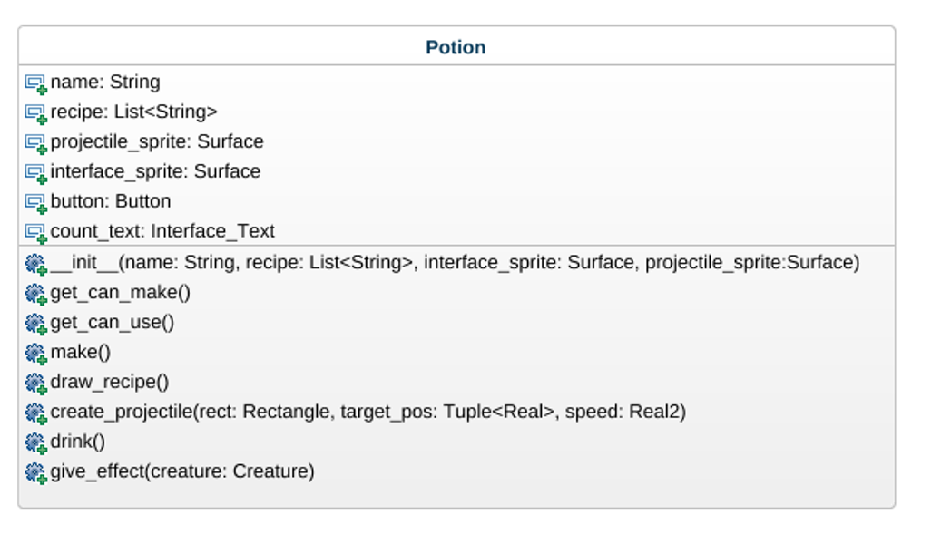
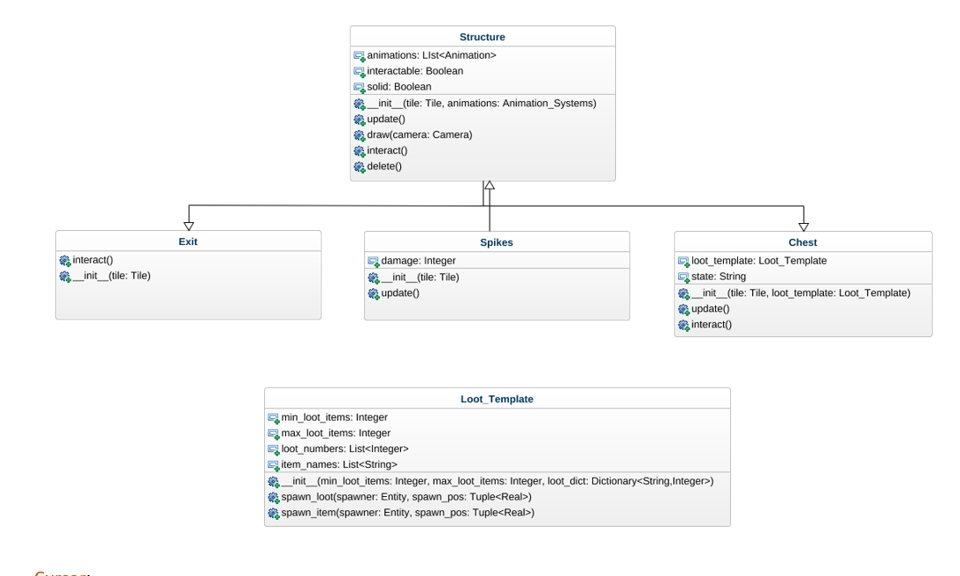
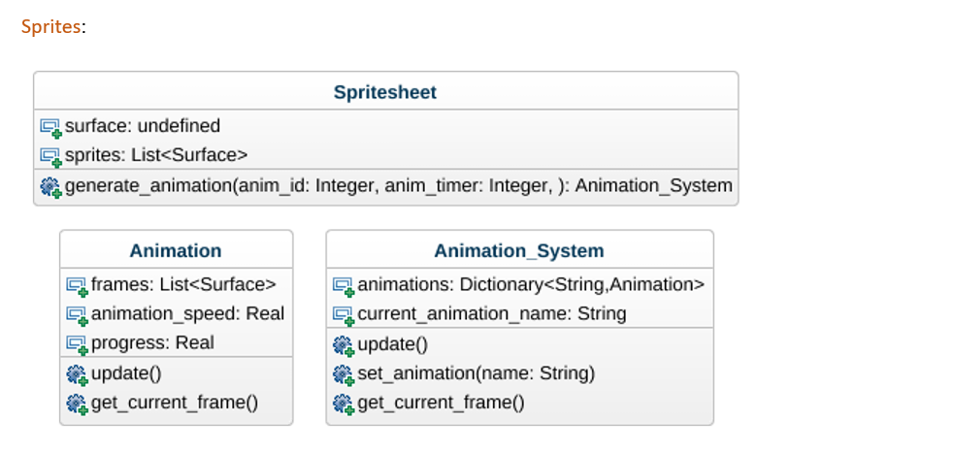

Slide 25
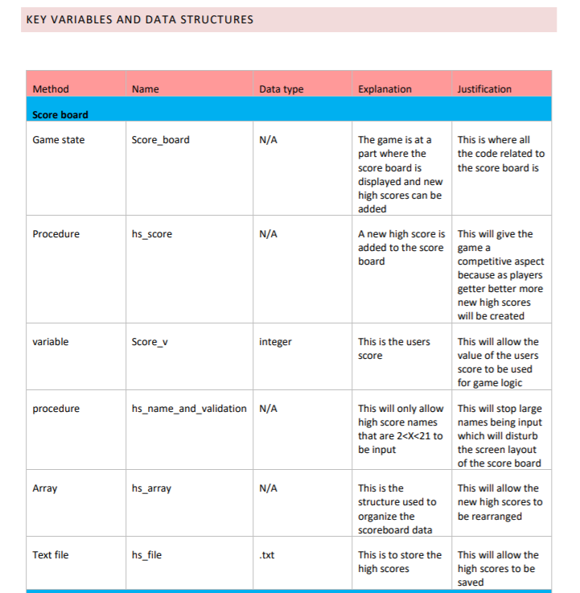
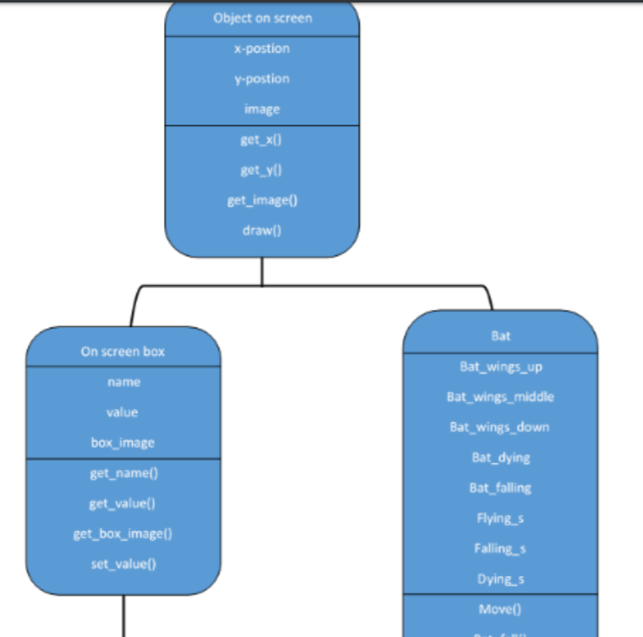

Slide 26
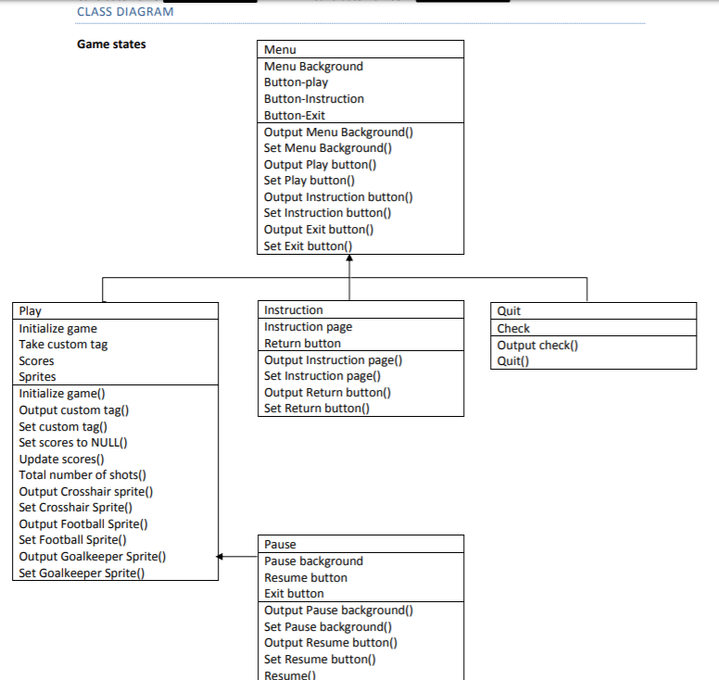

Slide 27
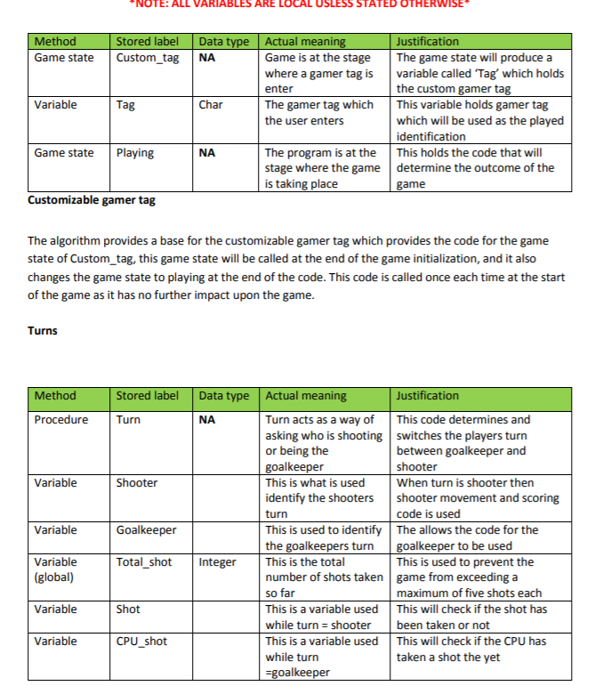

Slide 28
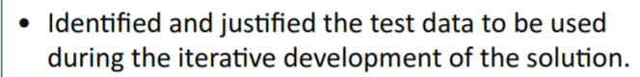
Require – Knowing the Mark scheme
How are you going to test your project during each stage of your development? Simple tests to check for validation.
Students over think this. Think about basic validation tests you will need to do. For example: if during iteration 2 you are developing the new high score component, you might have a table like this:
Each of the tests needs to be justified, why are you choosing to test this now?
Test Data | Type | Justification
new_score > highest_score | Valid | Need to record current new score as highest score if the new score is higher
New_score < highest_score | Invalid

Slide 29
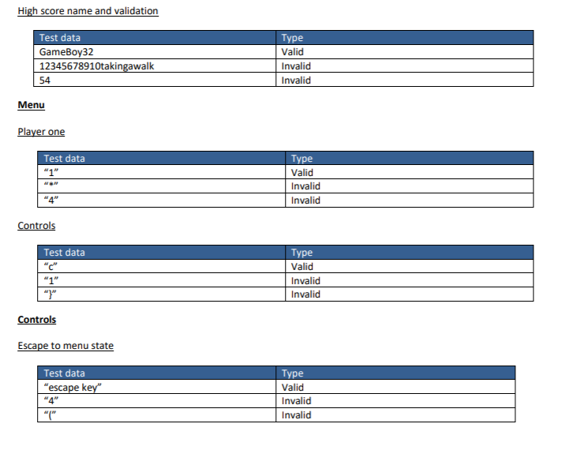

Slide 30
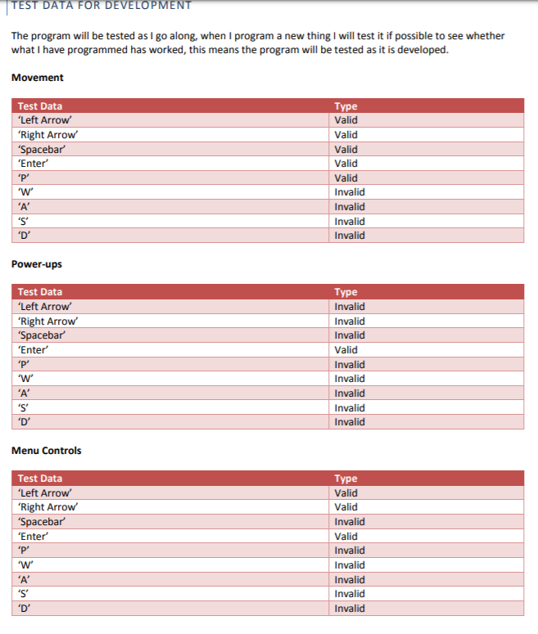

Slide 31
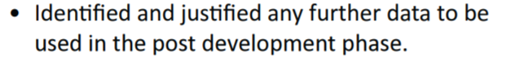
Require – Knowing the Mark scheme
This should be a test table that you will use again in your evaluation. What will you be testing post development to make sure it has met your success criteria and met the requirements set out in your analysis.
Another table like the one below will be perfect:
Each of the tests needs to be justified, why are you choosing to test this? Reference your success criteria and parts your design section if you need to.
Test | Description | Expected outcome | Justification

Slide 32
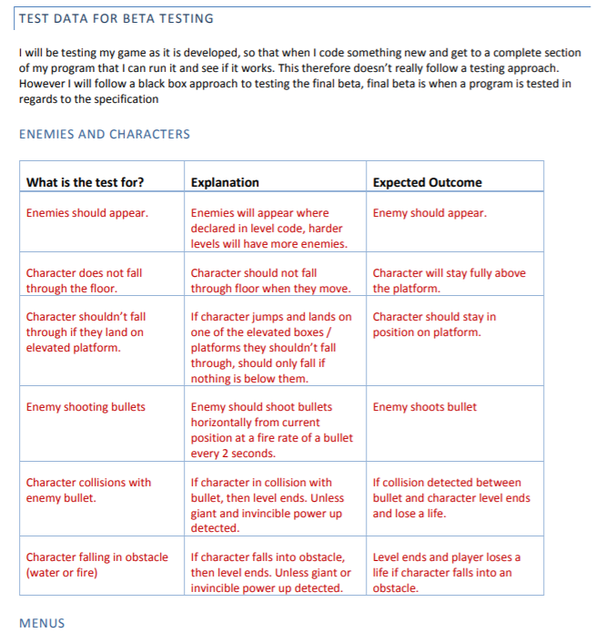

Slide 33
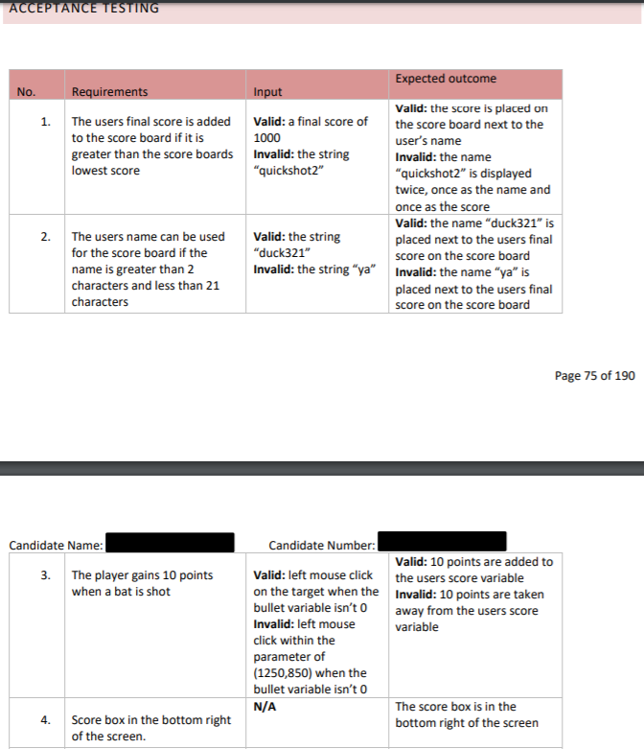

Slide 34
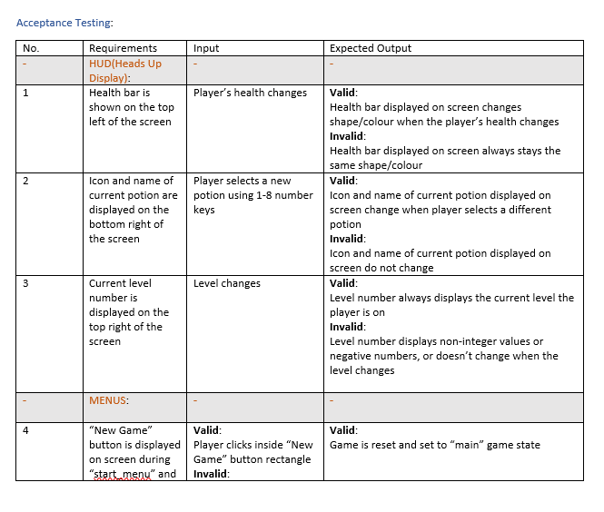

Slide 35
Require – Teacher advice
Follow the mark scheme. Copy and paste the headings for the higher band into your report and then use them as headings to make sure you are meeting them.
It’s a big section (15 marks) with a lot of work that needs to be done. You have lots of diagrams and algorithms to include, make sure you plan this out.
JUSTIFICATION is the most important word in the higher band of the mark scheme.
If you are stuck, do the following:
Use Candidate examples on OneNote
Read through the guidance on Firefly.
Contact us for advice.

Slide 36
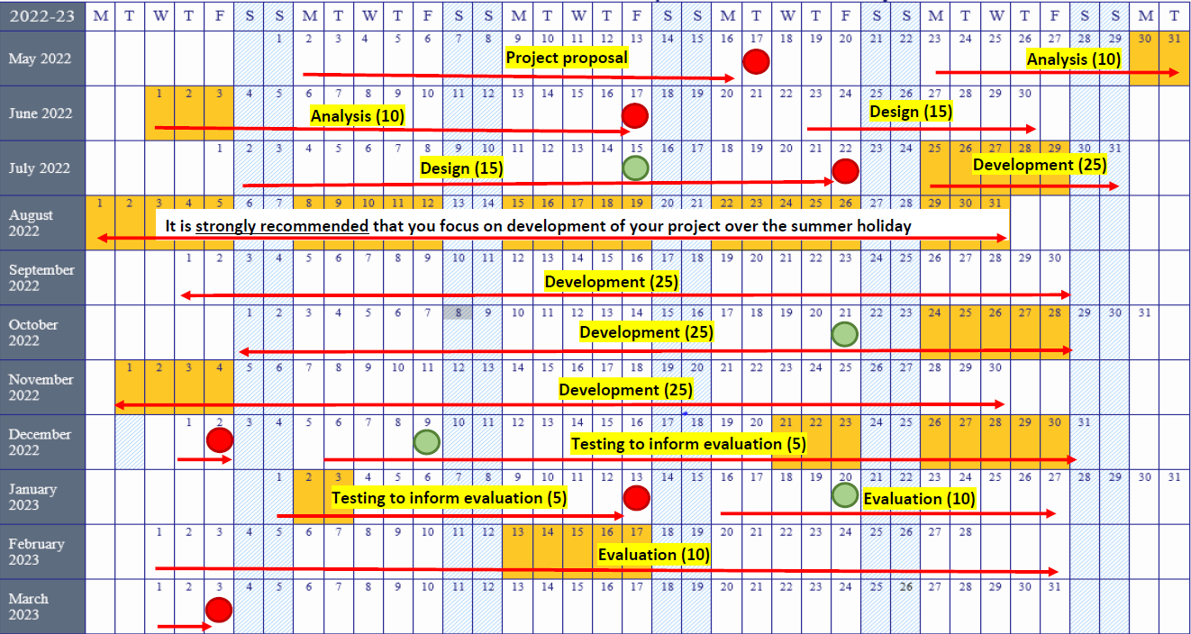
Action – Implement Design Section
The next deadline is 22nd July for the Design section.

Slide 37
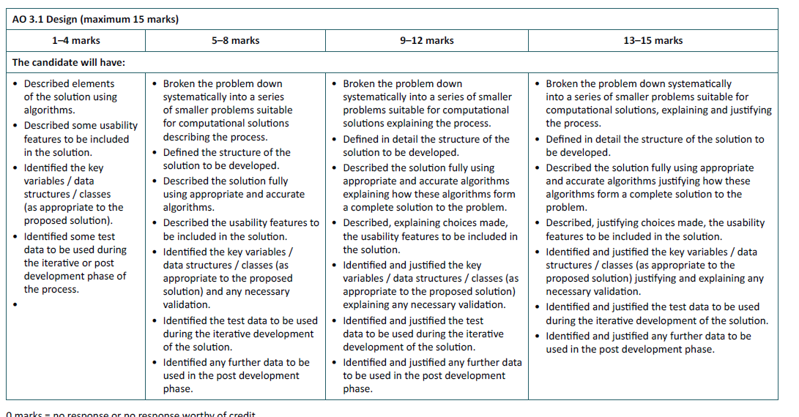
Review - Design

Slide 38
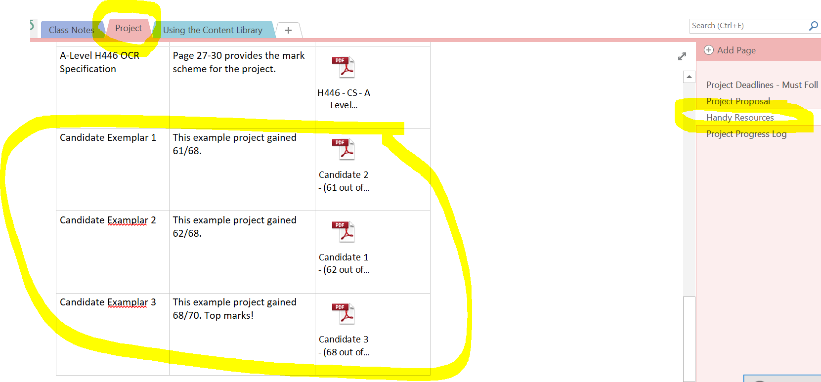
Review

